Slide 1


Slide 2
Problem statement
He shortens the time of going to the office and renting a car, so he can from the nearest point take a car and go
يقصر وقت ذهابه إلى المكتب واستئجار سيارة ليتمكن من أقرب نقطة له أن يأخذ سيارة ويذهب.

Slide 3
Brief about the project:
The app is to rent a car but not from a rental company
but from a person like you and me who owns a car and registered through this
app to rent his own car for other people to use.
التطبيق مخصص لاستئجار سيارة ولكن ليس من شركة تأجير
ولكن من شخص مثلك ومثلي يمتلك سيارة ويسجل من خلال هذا
التطبيق لتأجير سيارته الخاصة ليستخدمها الآخرون

Slide 4
Wireframe:
The same Car Type
Register NewUser
click the city
Request
:Car Type
Click The Request
City
List Cars
Click The City
Request
Request

Slide 5
img Car
ReviewDetails
Click The Review
Order details
Review

Slide 6
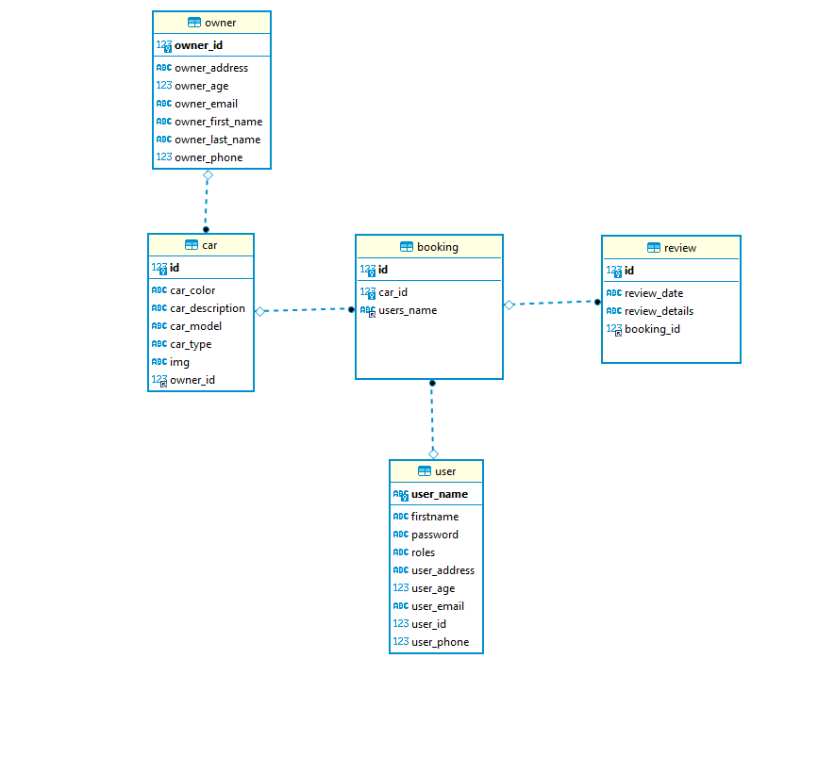
ER Diagram:

Slide 7
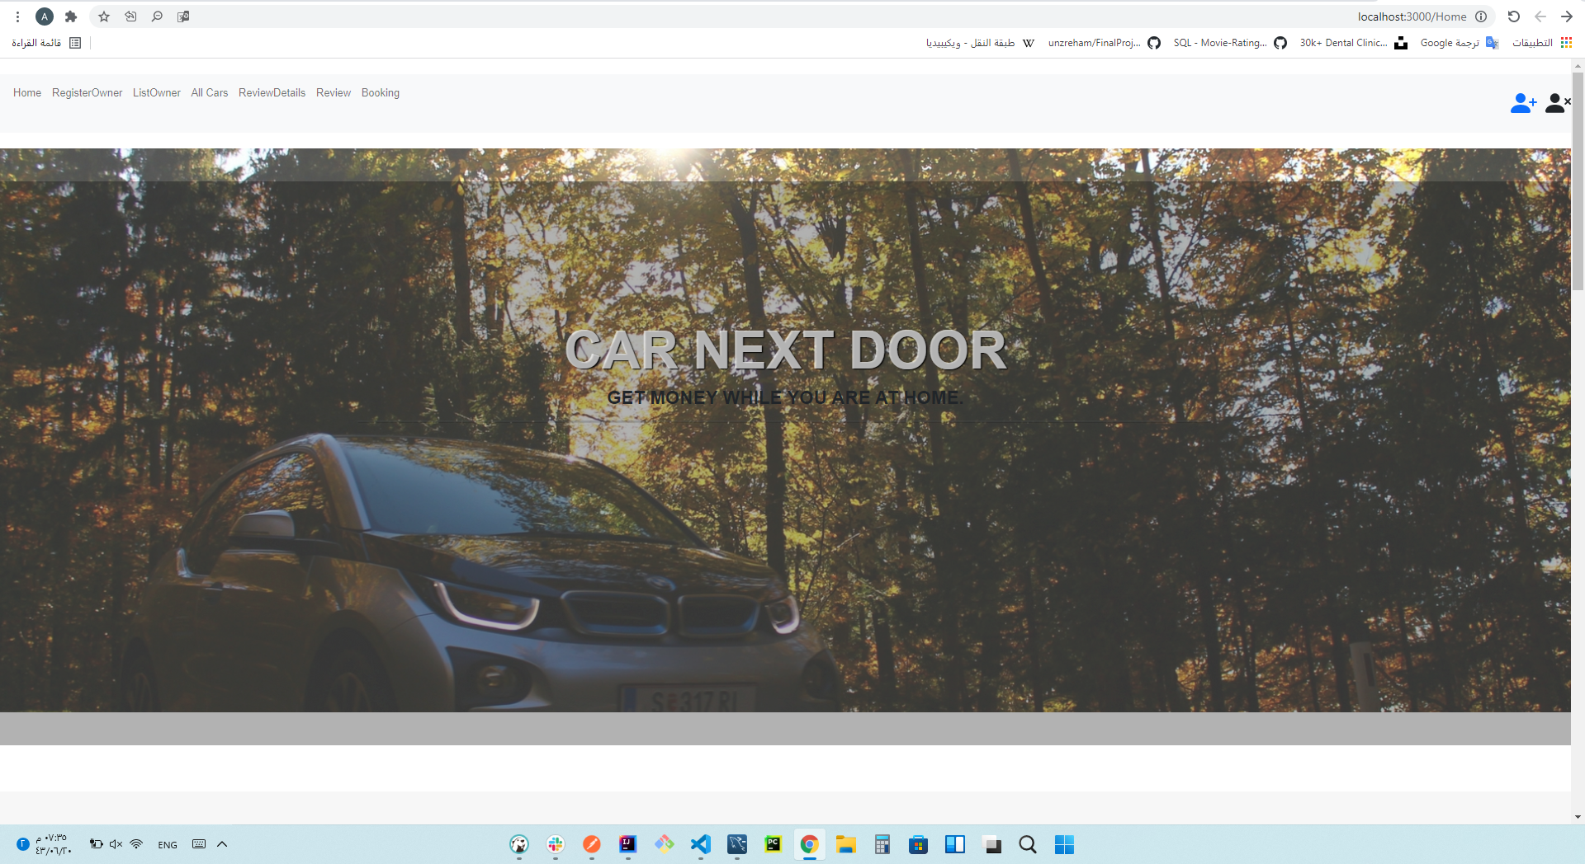
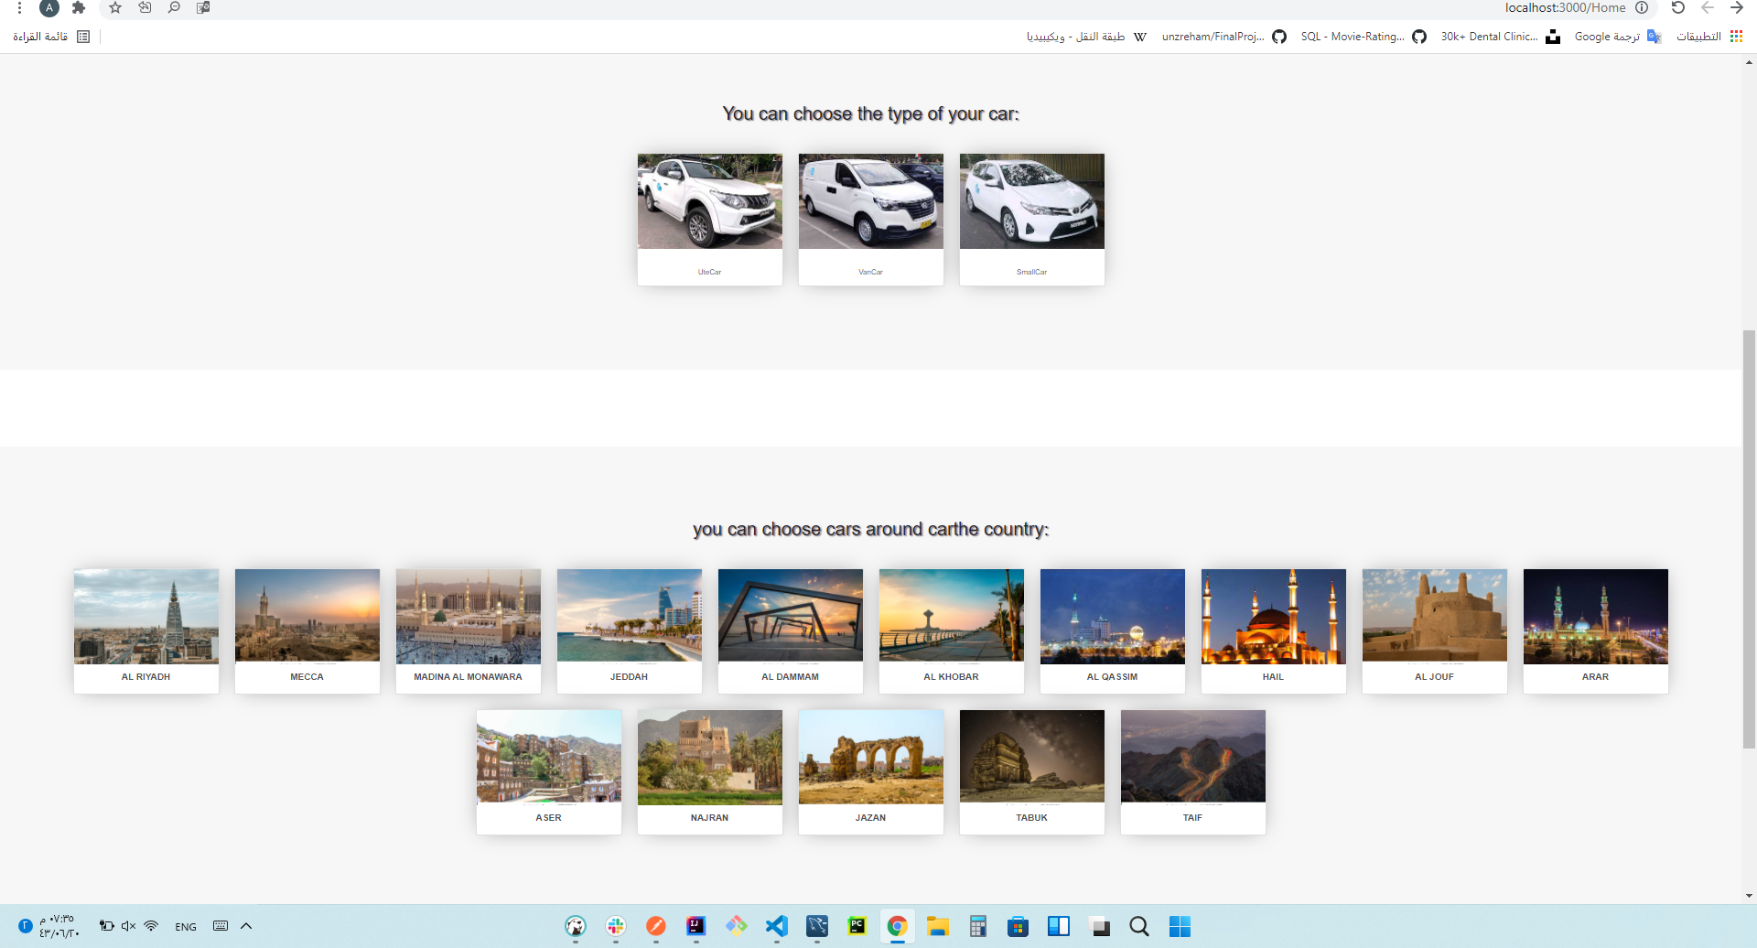
Demo of the project:
Home Page

Slide 8
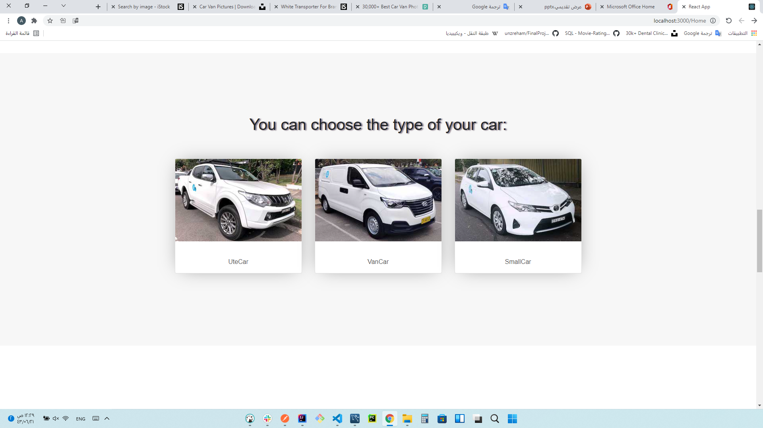
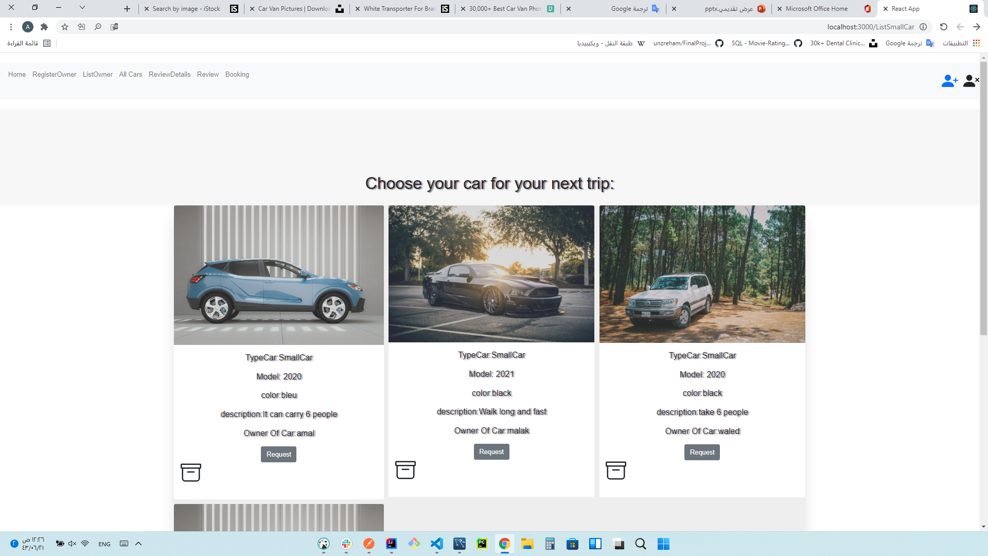
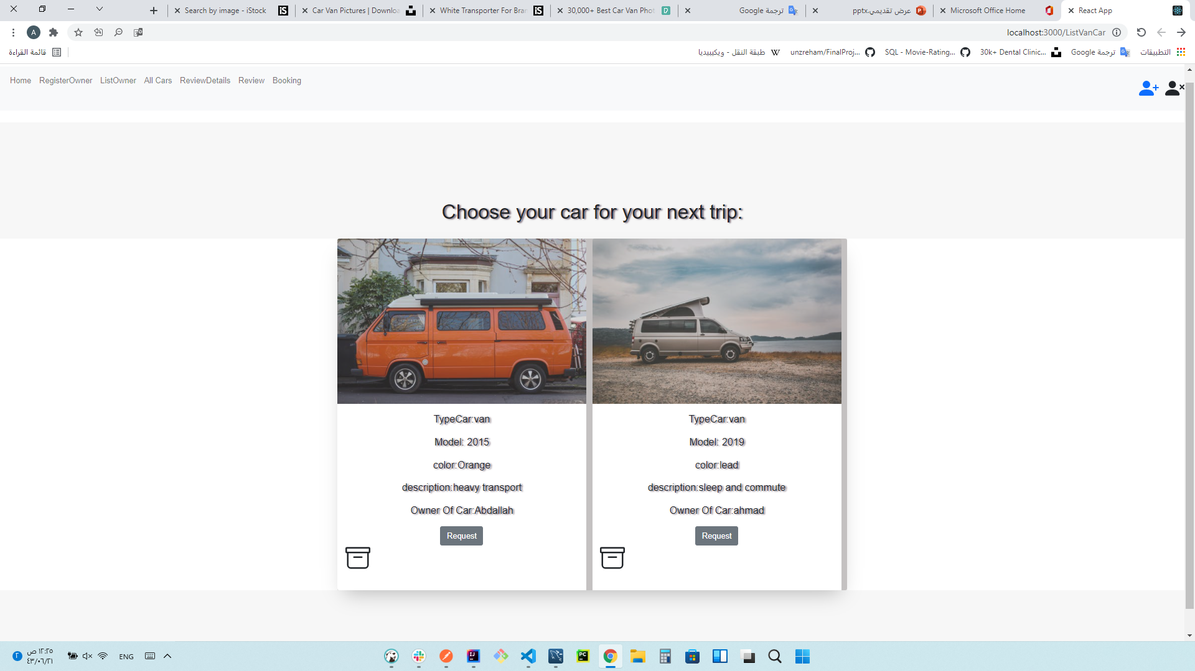
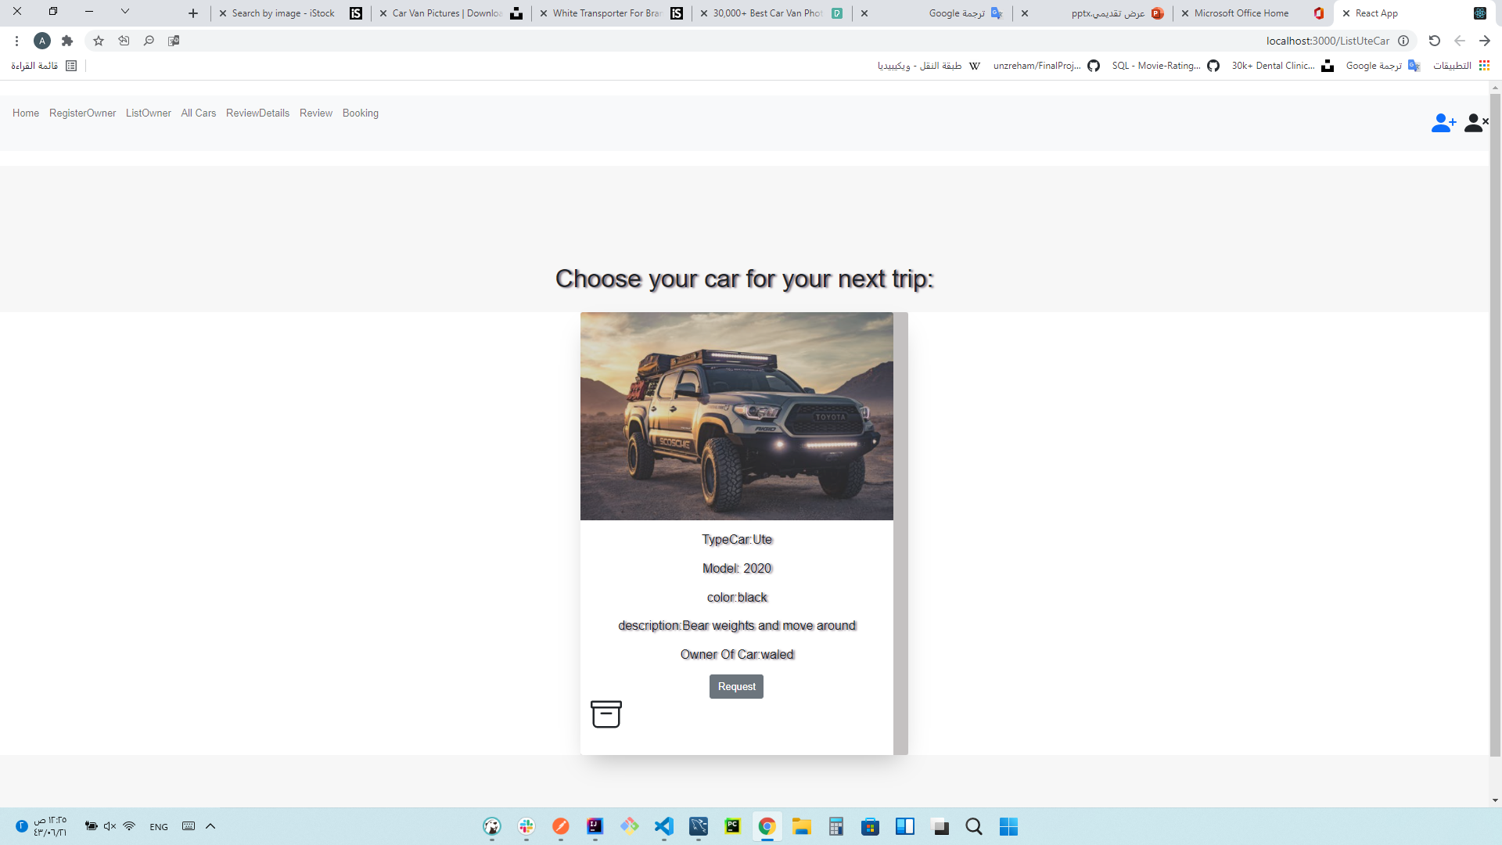
Every car and its type

Slide 9
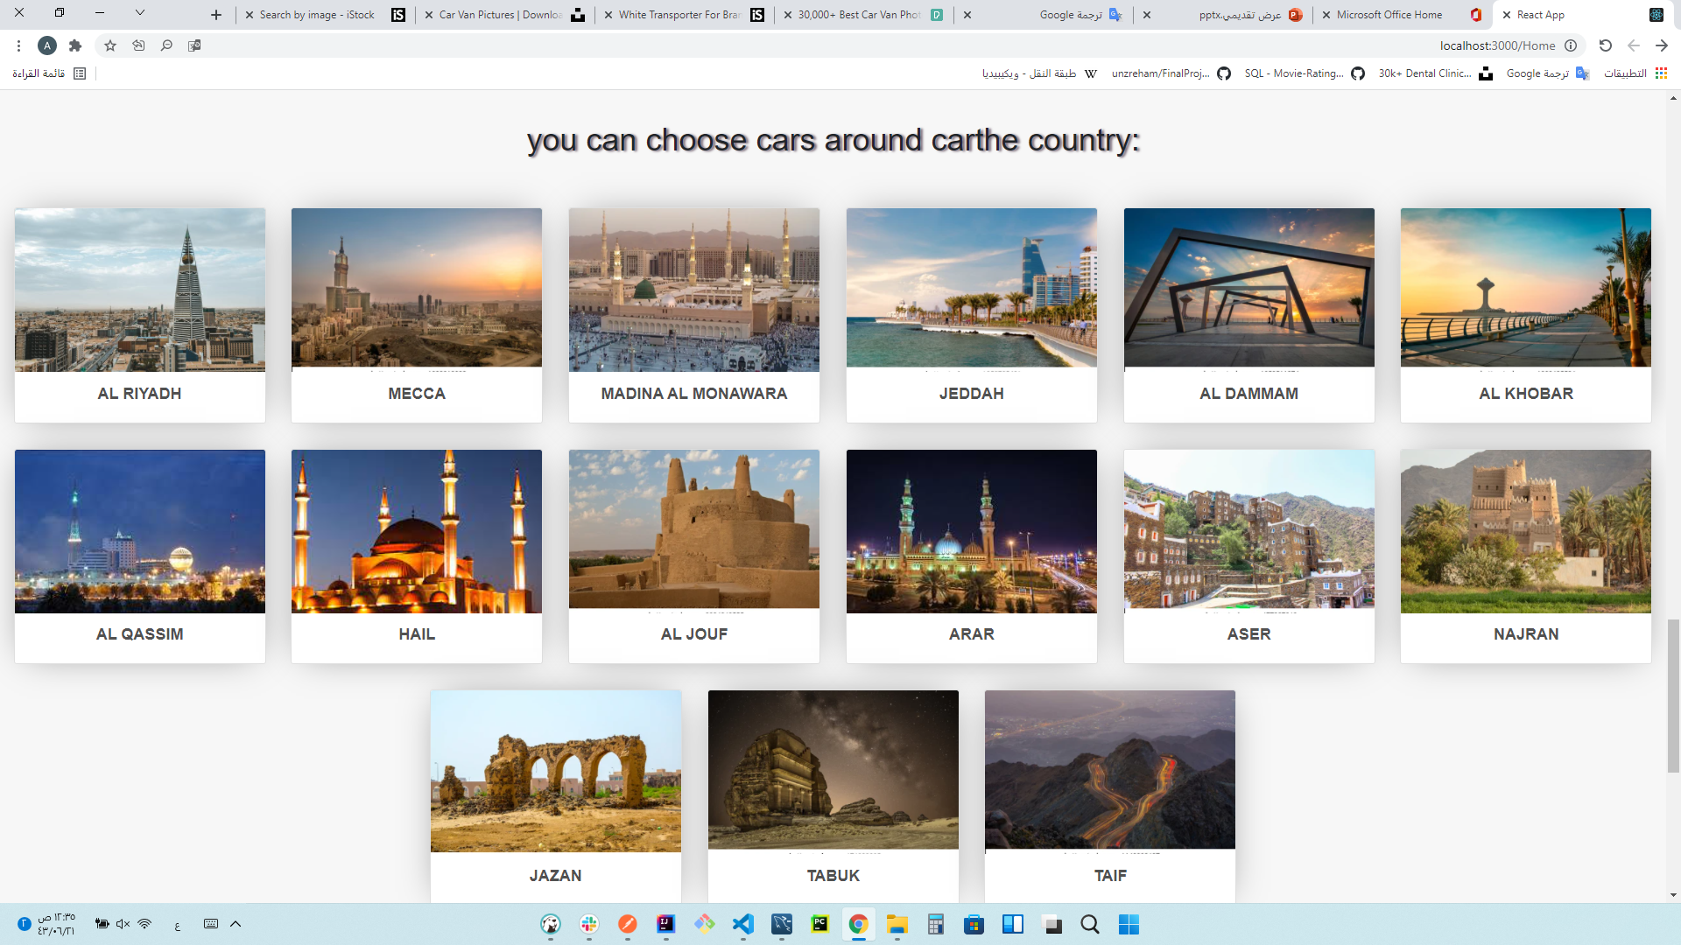
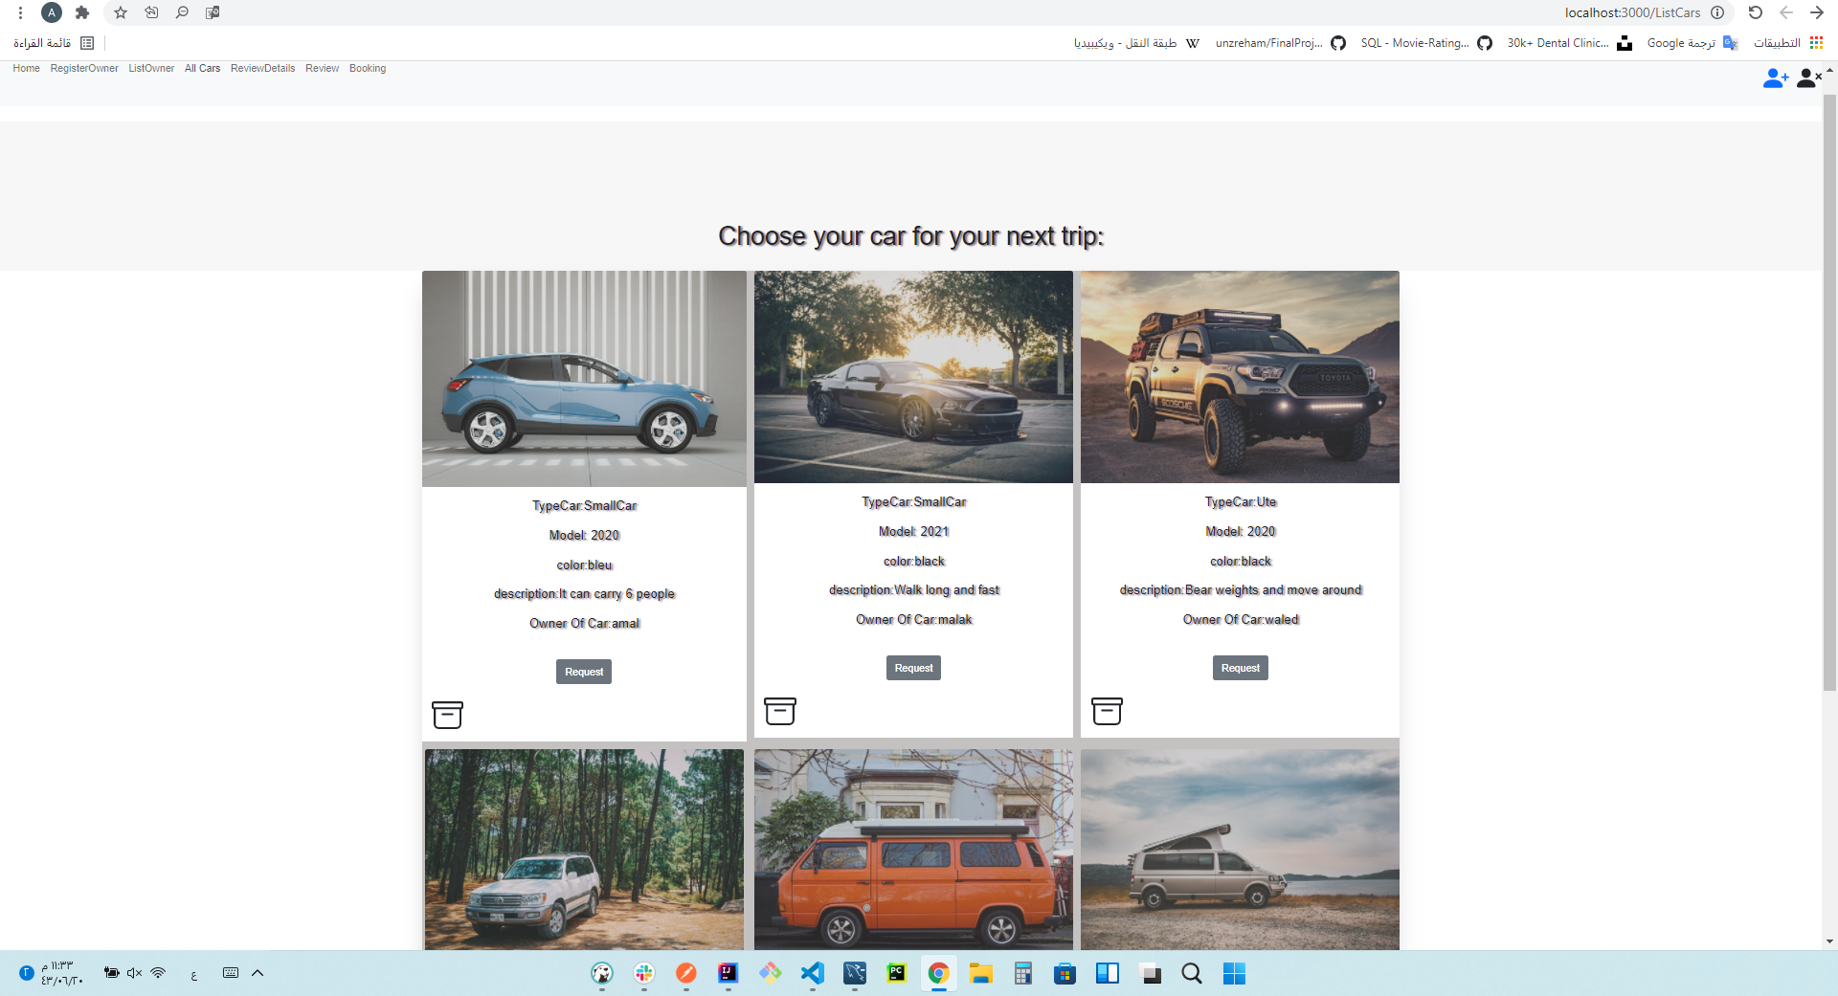

Slide 10
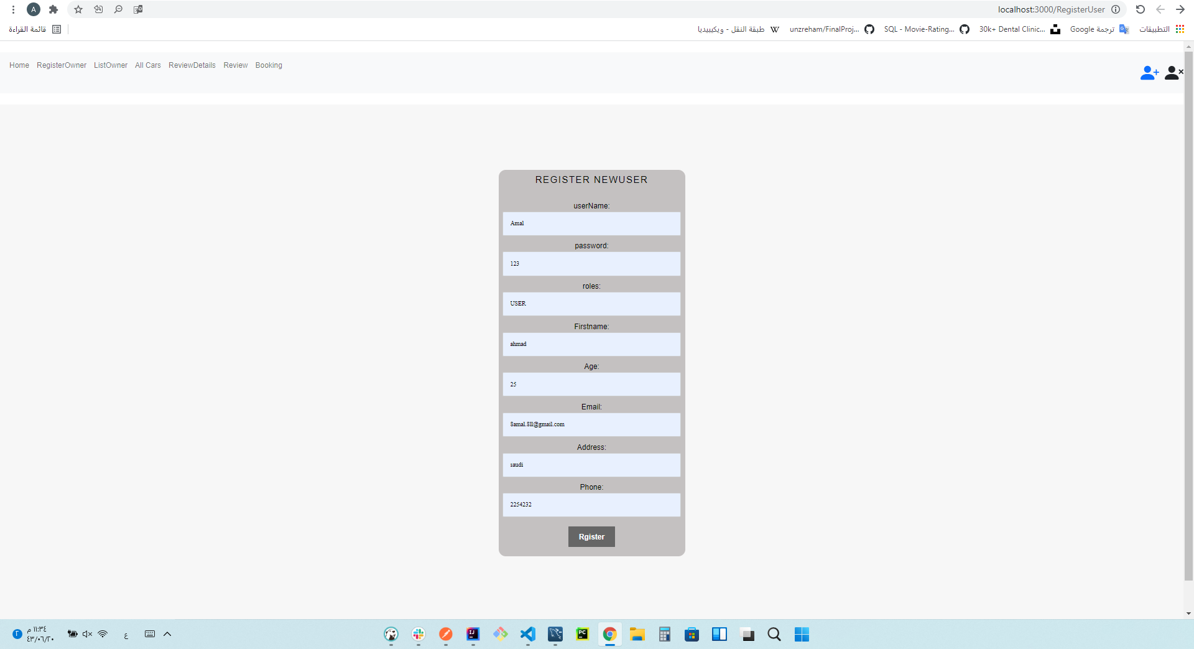
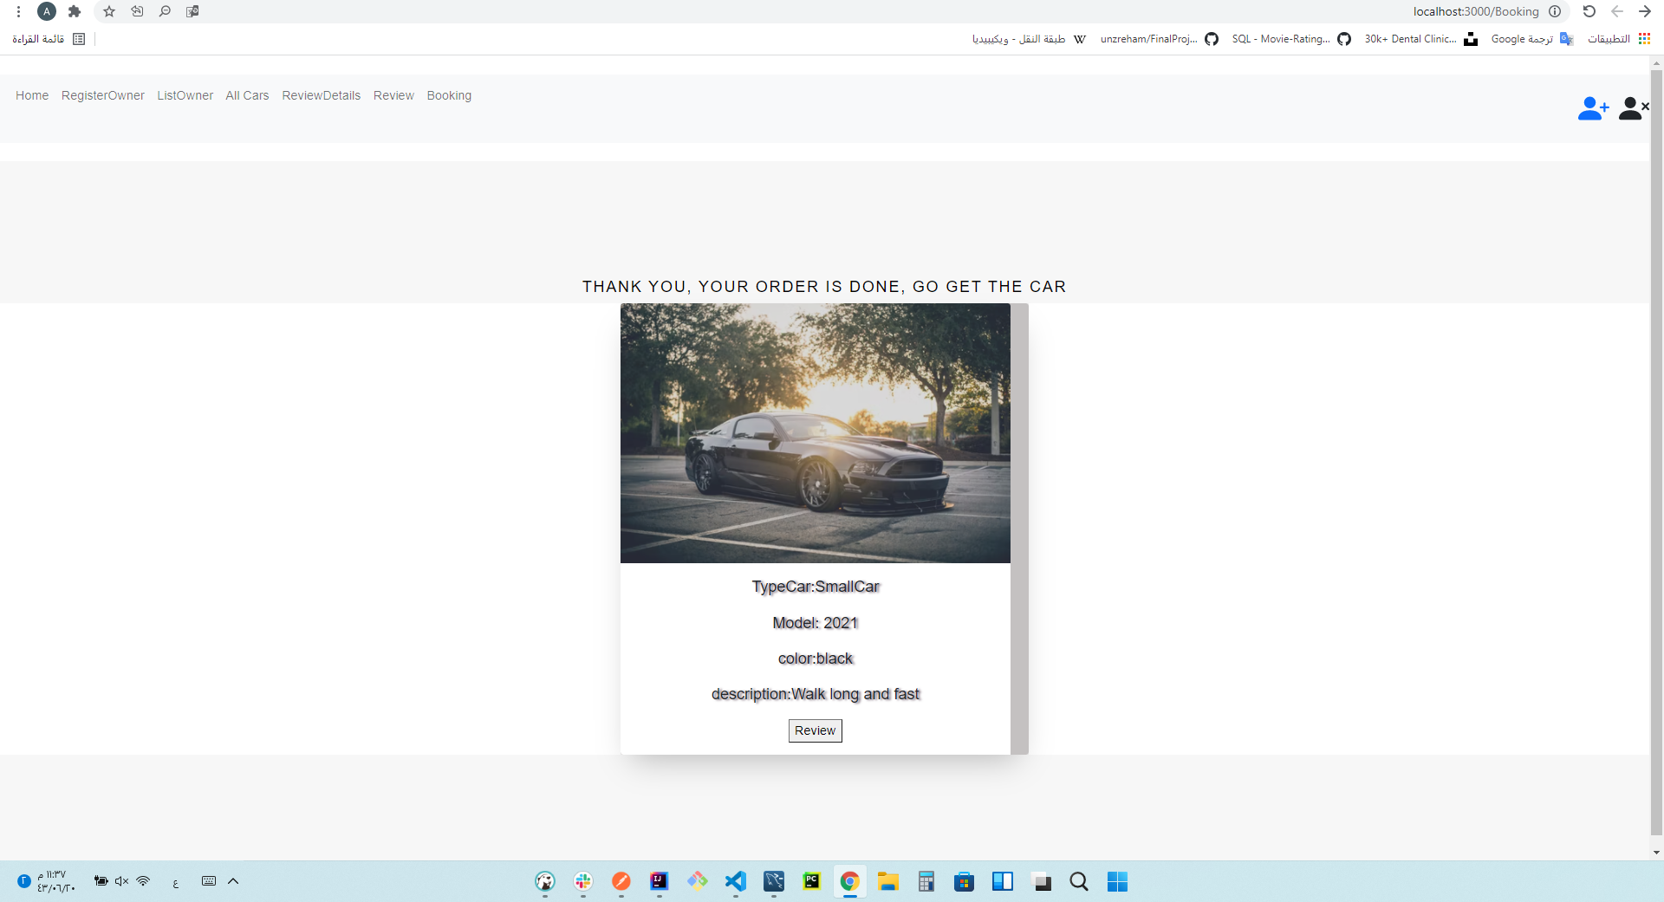
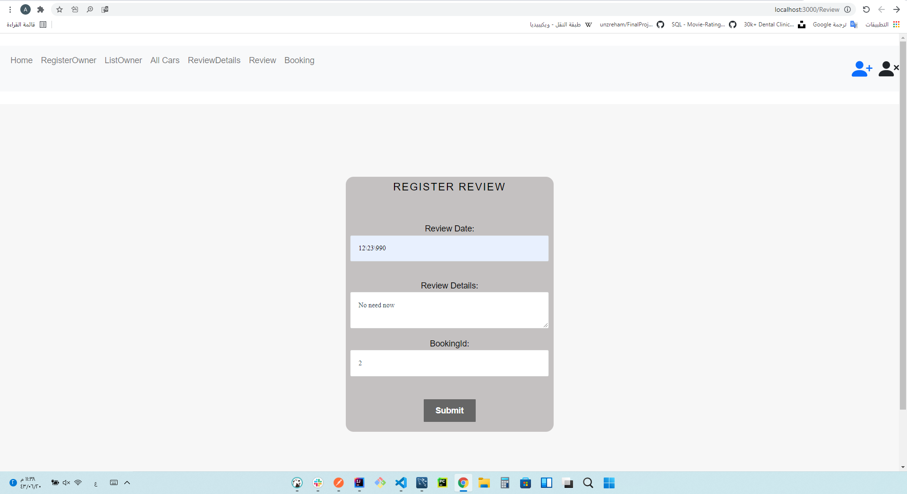
Upon request, the user must be registered
Request
ReviewDetails

Slide 11
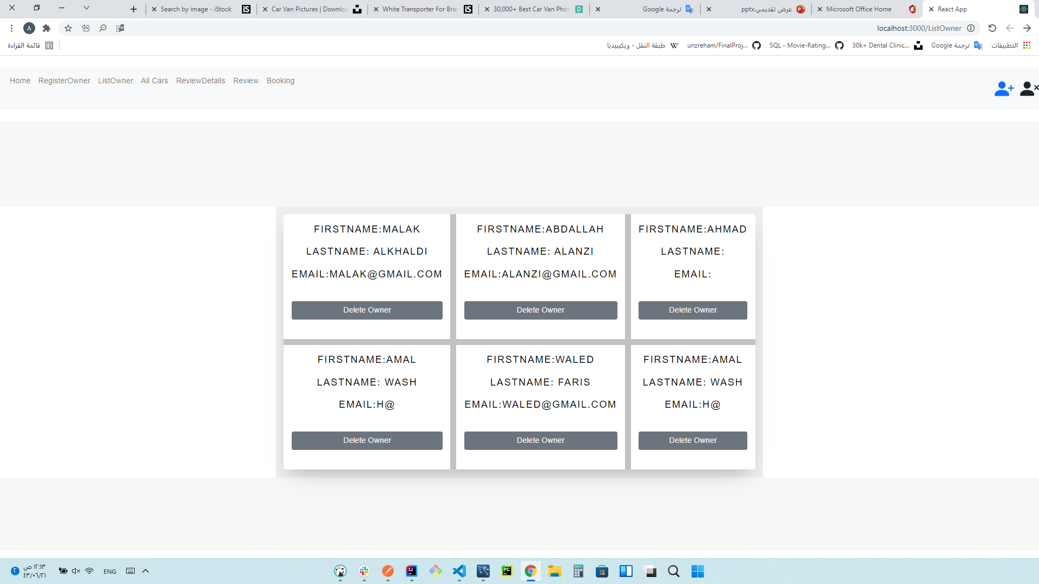
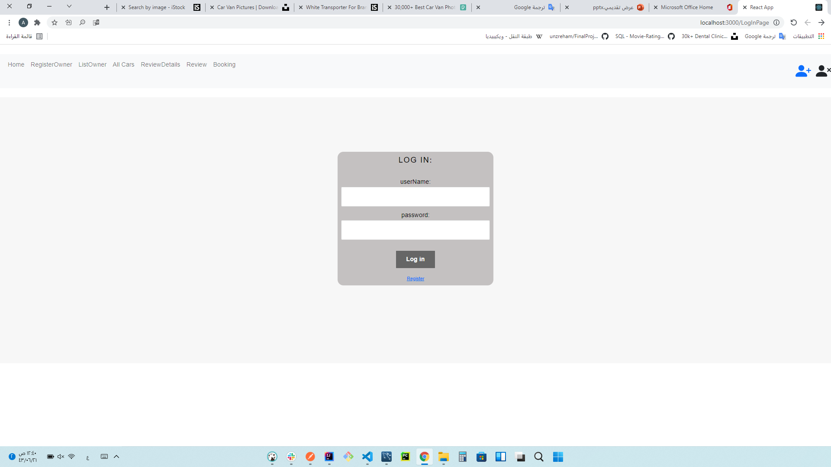
All List Car Owner
LogIn

Slide 12
Technologies used:
- BackEnd:
- Java(IntelliJ IDEA)
- Spring Boot
- Database(MYSQL)
- ForntEnd
-React (javascript-Html-css-bootstrap)
(visualstudio)

Slide 13
•What was the most difficult part of the project:
Work Git and Post from page to page

Slide 14
What was your favorite part of the project:
Last project in Tuwaiq
Relationships between tables
css

Slide 15
What are the new things you learned creating this application:
The connection between "Back-End and Front-End"
check relationships
reading error

Slide 16


